Slide 1
BANA COMPETITION – HEART ATTACH ANALYSIS
Data analytics approach
Student name: JIZE CHEN
Student number: 46278366

Slide 2
Agenda
Explanation of heart attack
Data Exploration
Model Development
Interpretation
Limitation of model

Slide 3

Explanation of heart attack
What is heart attach
A heart attack occurs when the flow of blood to the heart is severely reduced or blocked
Symptoms
Chest pain
Pain or discomfort that spreads to the shoulder, arm, back, neck, jaw, teeth or sometimes the upper belly
Cold sweat
Fatigue
Heartburn or indigestion
Lightheadedness or sudden dizziness
Nausea
Shortness of breath
("Cardiovascular disease risk | Health prevention series - HealthEngine Blog", 2022)

Slide 4
Data Exploration
Data quality assessment
Data quality dimension | Definition of each dimension | About the data set
Accuracy | correct values | Based on given data explanation, caa equal to 4 doesn’t make sense, so caa==4 is removed Assume thall = 0 means patient doesn’t has heart defeat
Completeness | Data fields with values | No incomplete data found
Consistency | Values free from contradiction | All values are free from contradiction
Currency | Value up to date | Assume all data are up to date
Relevancy | Data items with value meta-data | All variables are relevant
Validity | Data containing allowable values | Change data type of all categorical variables from decimal to factor so R can correctly examine the data
Uniqueness | Records that are duplicated | No duplicated data found

Slide 5
Data Exploration
Data dictionary
Variables | Explanation
Age | Patients’ age
Sex | Patients’ sexuality
Cp | Chest pain type Typical angina Atypical angina Non-typical angina Asymptomatic
Trtbps | Resting blood pressure
Chol | Cholesterol in mg/dl fetched via BMI sensor
Fbs | Fasting blood sugar Blood sugar > 120 mg/dl 0. Blood sugar <= 120 mg/dl
Restecg | Resting electrocardiographic results: Normal Having ST-T wave abnormality showing probable or definite left ventricular hypertrophy
Thalachh | Maximum heart rate
Variables | Explanation
Exng | Exercise induced angine: 0. no 1. yes
Oldpeak | ST depression induced by exercise relative to rest
Slp | The slope of the peak experience ST segment
Caa | Number of major vessels (0-3) coloured by fluoroscopy
thall | Heart defeat type 0. No heart defeat detected 1. Normal 2. Fixed defeat 3. Reversible defeat
Output* | chance of heart attack: 0. Lower chance 1. Higher chance

Slide 6
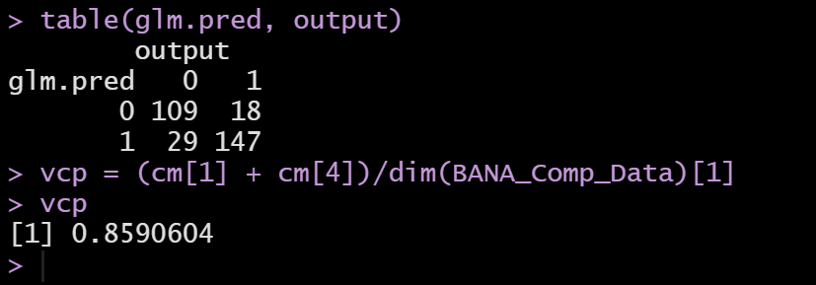
Model development
Generalized linear model
Generate logistic regression model with glm in R
Confusion matrix and its training error rate is shown on the right. In general, the glm model has low training error rate which is less than 15%

Slide 7
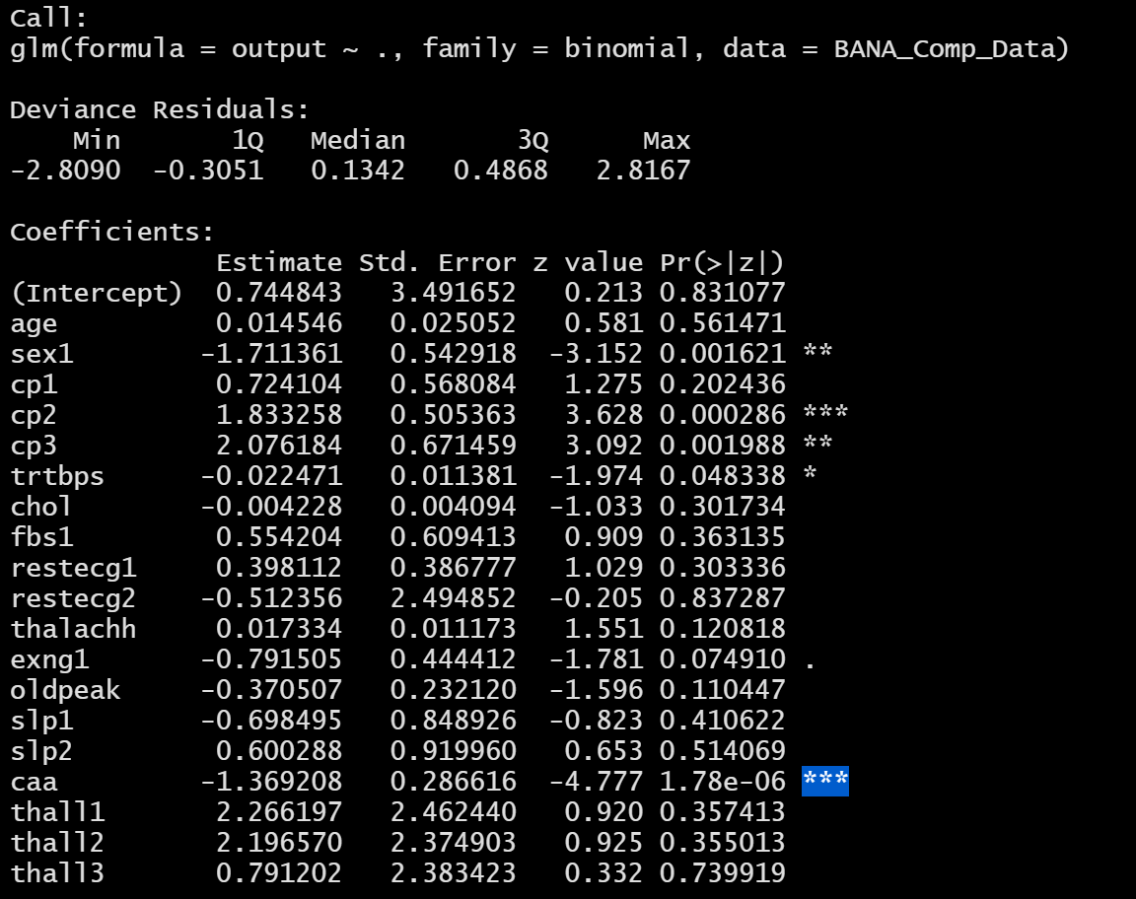
Interpretation
Significant factor (p test)
Based on the P test on the right, the following 4 variables explains more about occurrence of heart attack than others(order by significant level)
cp (chest pain type)
caa (number of major vessels (0-3) coloured by fluoroscopy)
sex
thall (heart defeat type)

Slide 8
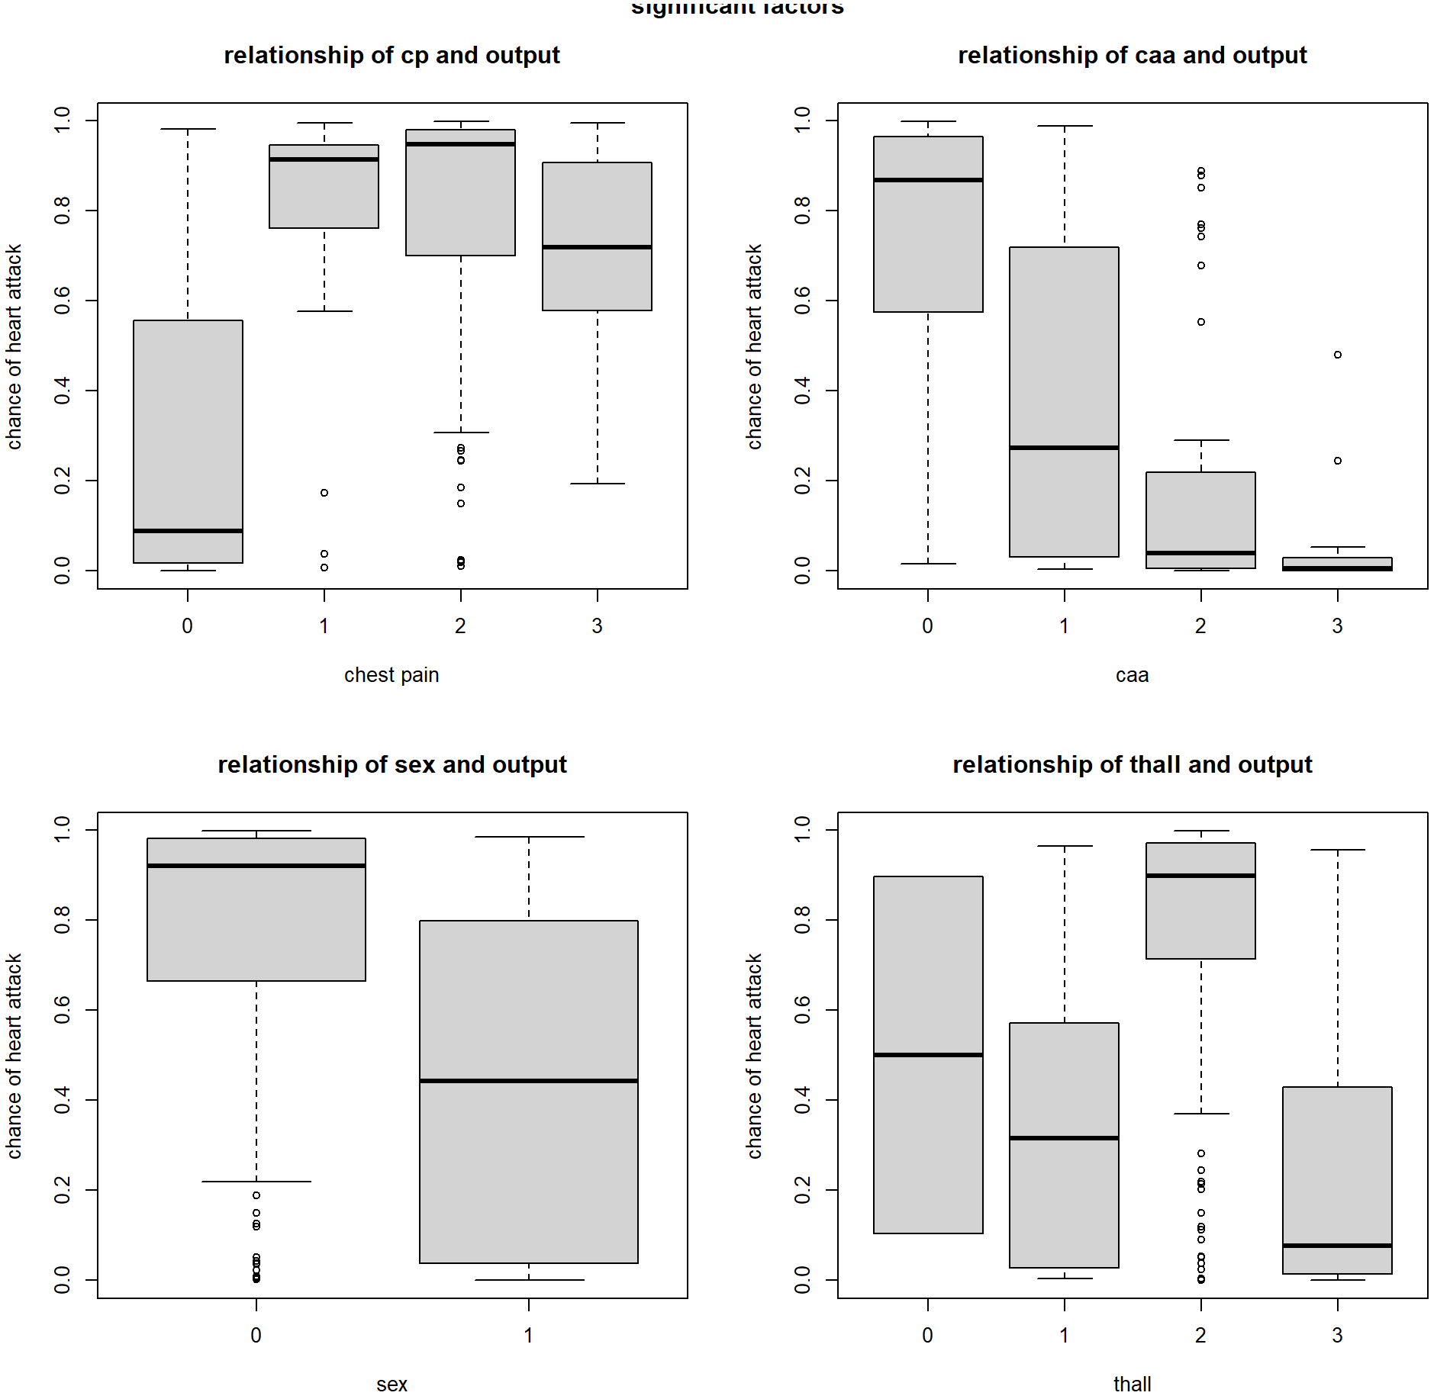
Interpretation
Who has higher chance of getting heart attack
On the right is the graph of significant factors of heart attack which include cp, caa, sex and thall
Patient with following characteristic has higher chance of heart attack
patient suffers from atypical angina, non-typical angina and asymptomatic
Patient who has 0 major vessels coloured by fluoroscopy
Patient who is male
Patient who is fixed defeat

Slide 9
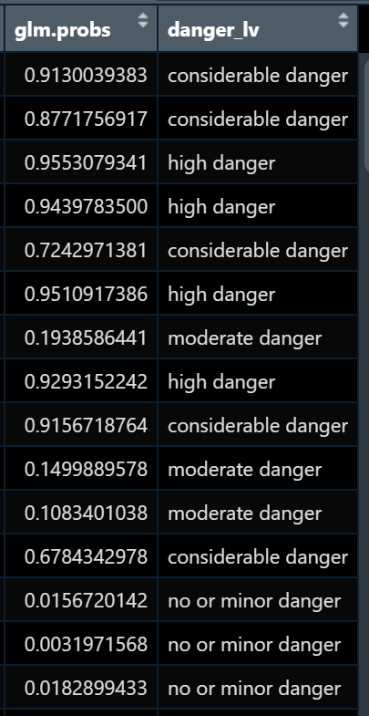
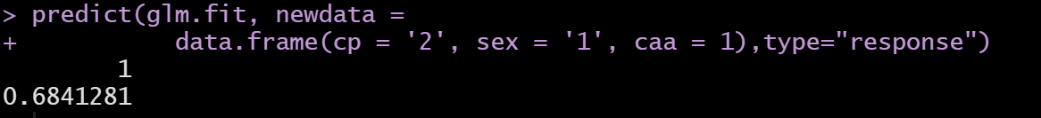
How can the model reduce the cost of heart attacks on society
Predict
Predict which patient would have higher chance of receiving a heart attack
Prevent
Prevent risks because of low accuracy prediction or no prediction
Protect
Protect patient from heart attack
Prevent bias (cognitive bias, confirmation bias…)
Protect the resource from wasting (false calls)
Patient classification

Slide 10
Limitations and possible solutions of model
Limitations
Possible solutions
Because whole data set was used for training and testing, the variance of this model is low. In other word, the prediction power of this model on new data will be relatively low
Most of the variables doesn’t explain much of the output of the model which might also cause the model of overfitting
Other models might outperformed logistic regression model in this data set
Use cross validation approaches like leave 1 out validation, k fold validation to improve the model on testing data set
Use dimension reduction method like principal component analysis or partial least square to mitigate overfitting
Construct models using methods like linear probability model, polynomial model, k-nearest neighbour model and compute their training error and testing error to determine which model has the best prediction power for this data set

Slide 11
Reference
Cardiovascular disease risk | Health prevention series - HealthEngine Blog. (2022). Retrieved 5 October 2022, from https://healthinfo.healthengine.com.au/cardiovascular-disease-risk-health-prevention-series
Heart attack - Symptoms and causes. (2022). Retrieved 4 October 2022, from https://www.mayoclinic.org/diseases-conditions/heart-attack/symptoms-causes/syc-20373106
Heart attack - Symptoms and causes. (2022). Retrieved 4 October 2022, from https://www.mayoclinic.org/diseases-conditions/heart-attack/symptoms-causes/syc-20373106#:~:text=A%20sudden%20change%20in%20the,cardiac%20death)%20without%20immediate%20treatment.

